Slide 1

Introduction to Deep Learning and its Real world applications

Slide 2


List Of Contents
Deep Learning, a sub branch of ML
What exactly is deep learning?
Role of neural network in DL
Basic structure of Neural Network
neurons, weights, biases
Activation functions (ReLU, sigmoid)
neural networks learn using loss functions and gradient descent
Concept of Back Propagation
Types of neural networks (FNNs and CNNs)
7. Dicussion,Conclusion and Refrences

Slide 3
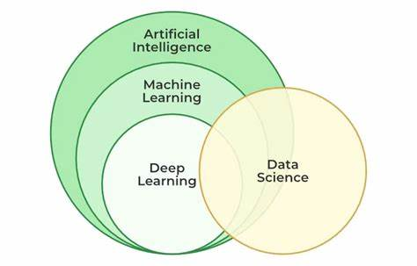
7. Dicussion,Conclusion and Refrences

Slide 4
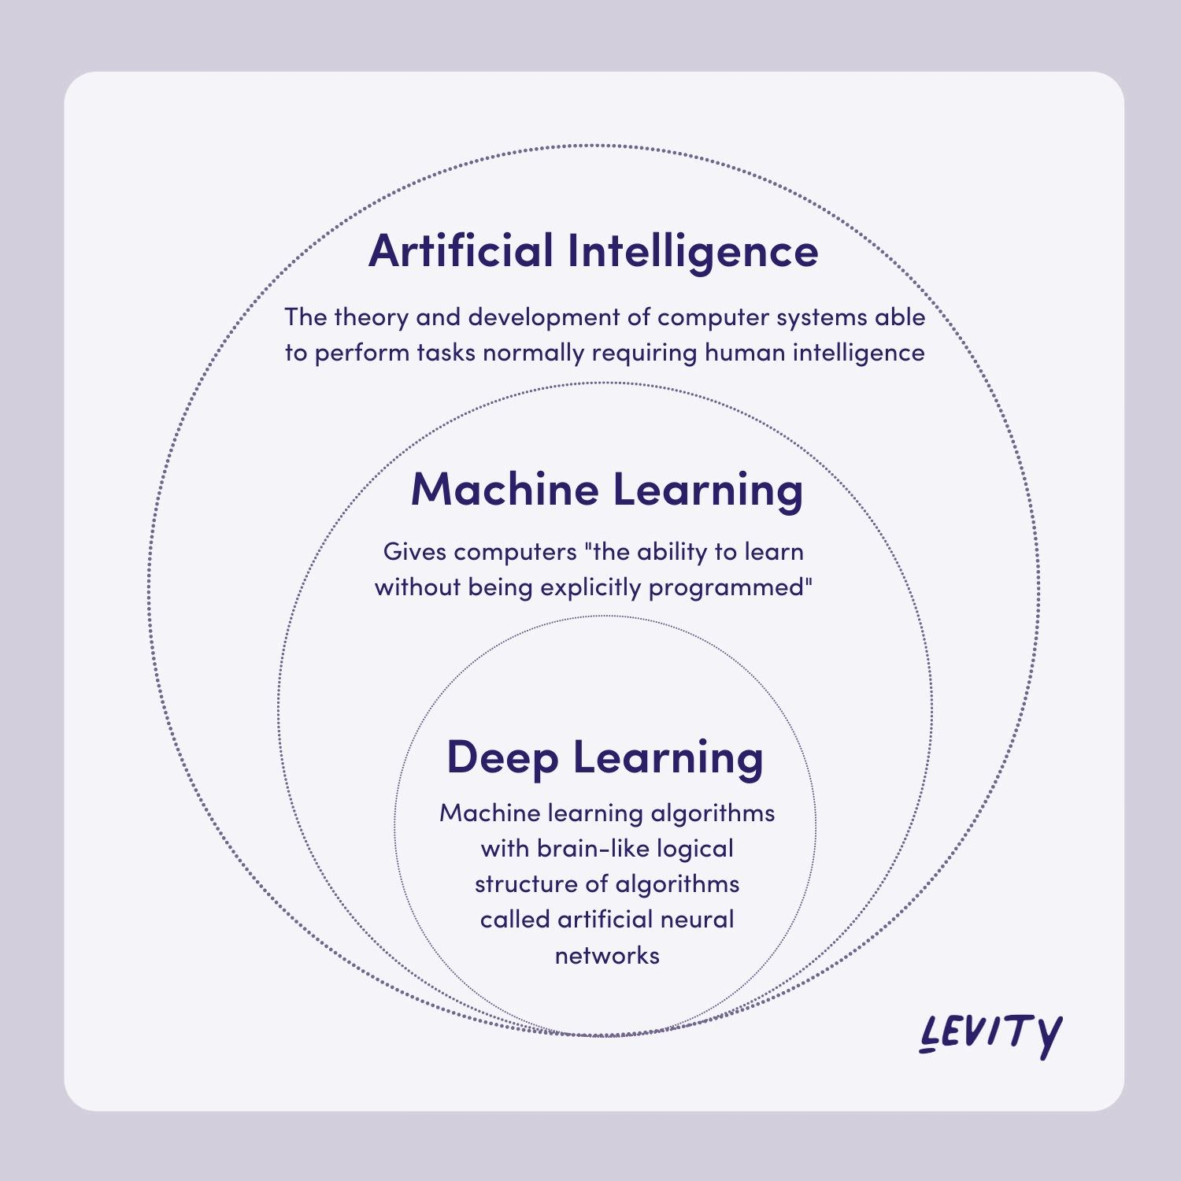
7. Dicussion,Conclusion and Refrences

Slide 5
Deep Learning
Deep learning, a subset of machine learning, involves training artificial neural networks to mimic the workings of the human brain for decision-making and pattern recognition
It is a type of machine learning inspired by human brain.
4
7. Dicussion,Conclusion and Refrences

Slide 6
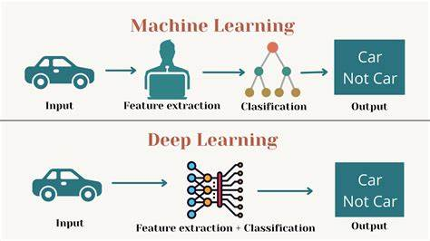
7. Dicussion,Conclusion and Refrences

Slide 7
How DL differs from ML
ML:
Performs well on smaller datasets with well-structured data.
Features need to be manually extracted and selected by human experts.
DL:
Requires large amounts of data to perform effectively.
Automatically extracts features and patterns from raw data, reducing the need for manual intervention.
4
7. Dicussion,Conclusion and Refrences

Slide 8
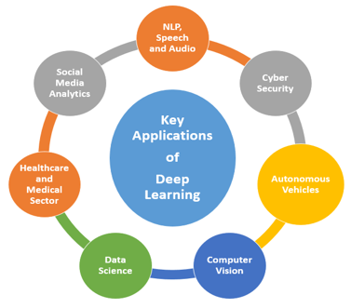
4
7. Dicussion,Conclusion and Refrences

Slide 9
Applications of Deep Learning
1. Medical Imaging: Deep learning models analyze X-rays, MRIs, and CT scans to detect conditions like cancer, fractures, or tumors. For instance, Google's DeepMind has developed systems to detect diabetic retinopathy with high accuracy.
2. Chatbots and Virtual Assistants: Assistants like Siri, Alexa, and Google Assistant use deep learning for speech recognition and response generation.
4
7. Dicussion,Conclusion and Refrences

Slide 10
3. Sentiment Analysis: Businesses analyze customer feedback or social media posts to understand public sentiment using deep learning models.
4. Fraud Detection: Anomalies in transaction data are identified by deep learning models, reducing the risk of financial crimes. PayPal uses such systems to detect fraudulent activities.
4
7. Dicussion,Conclusion and Refrences

Slide 11
5. Product Recommendations: Platforms like Amazon and Netflix use deep learning to analyze user behavior and suggest products or content
6. Visual Search: Customers can upload images of products to find similar items using deep learning-based image recognition systems..
4
7. Dicussion,Conclusion and Refrences

Slide 12
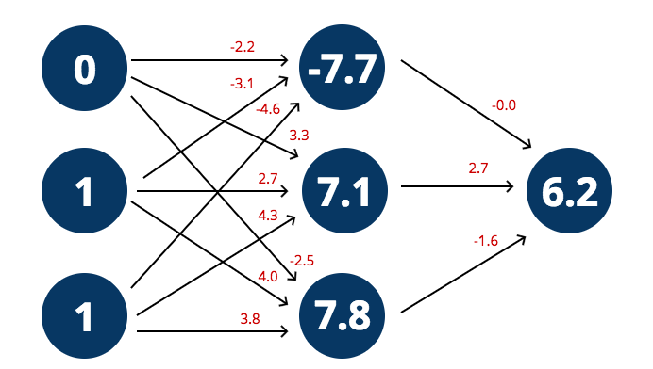
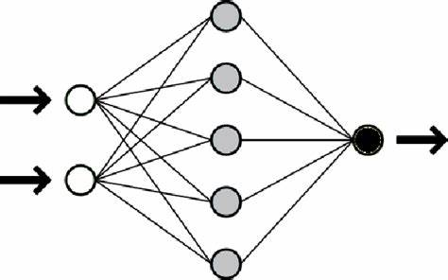
Role of Neural Networks in Deep Learning:
4
7. Dicussion,Conclusion and Refrences

Slide 13
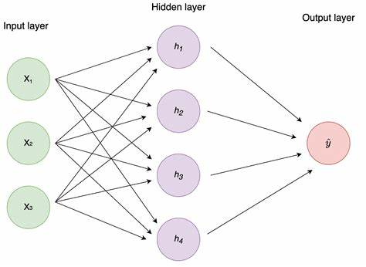

Slide 14

Multilayer perceptron algorithm

Slide 15
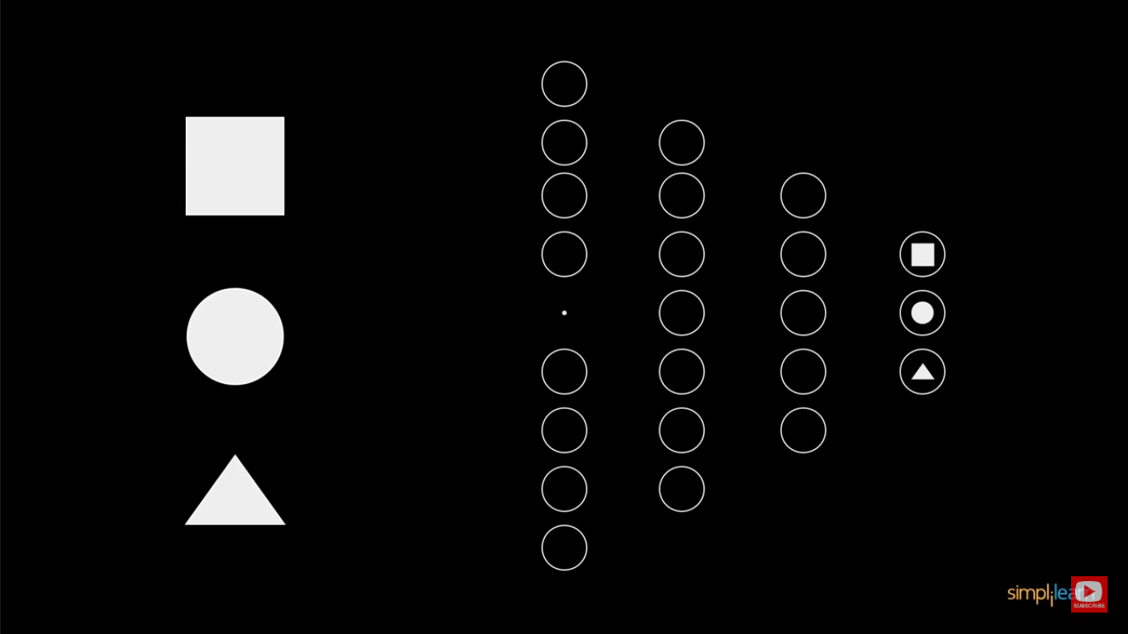

Slide 16
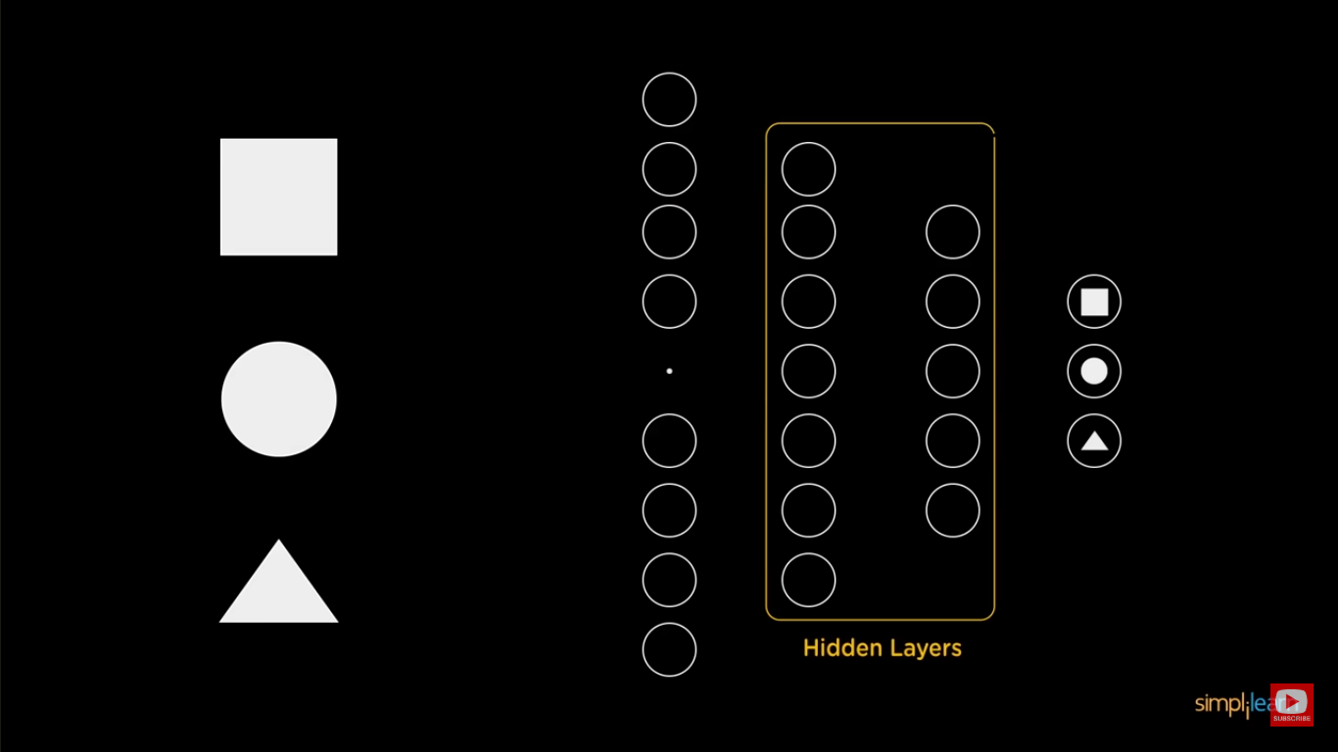

Slide 17
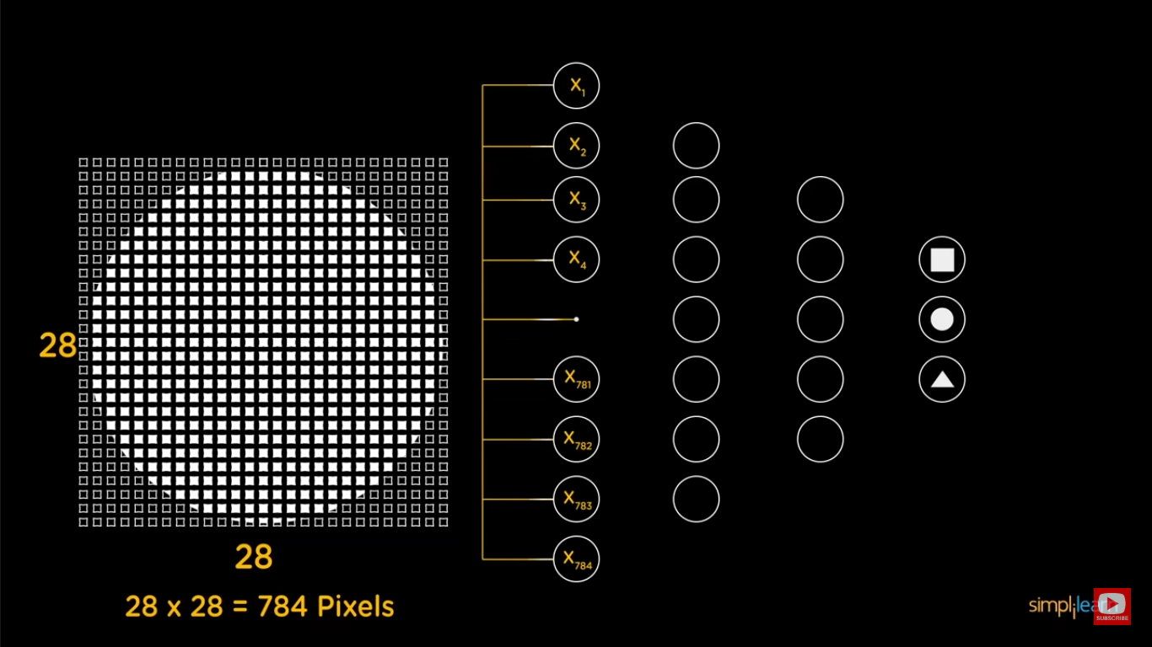

Slide 18
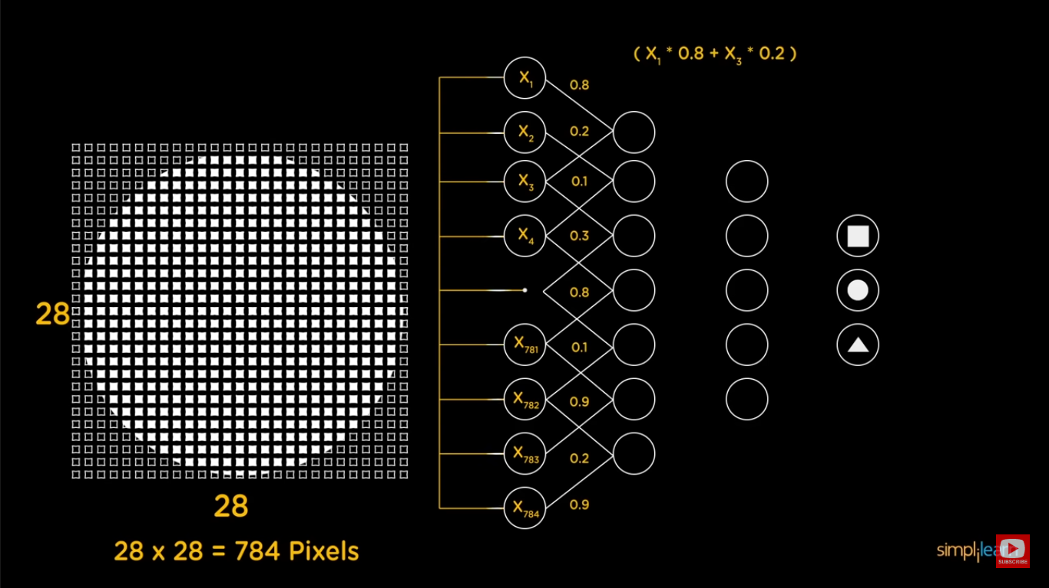

Slide 19
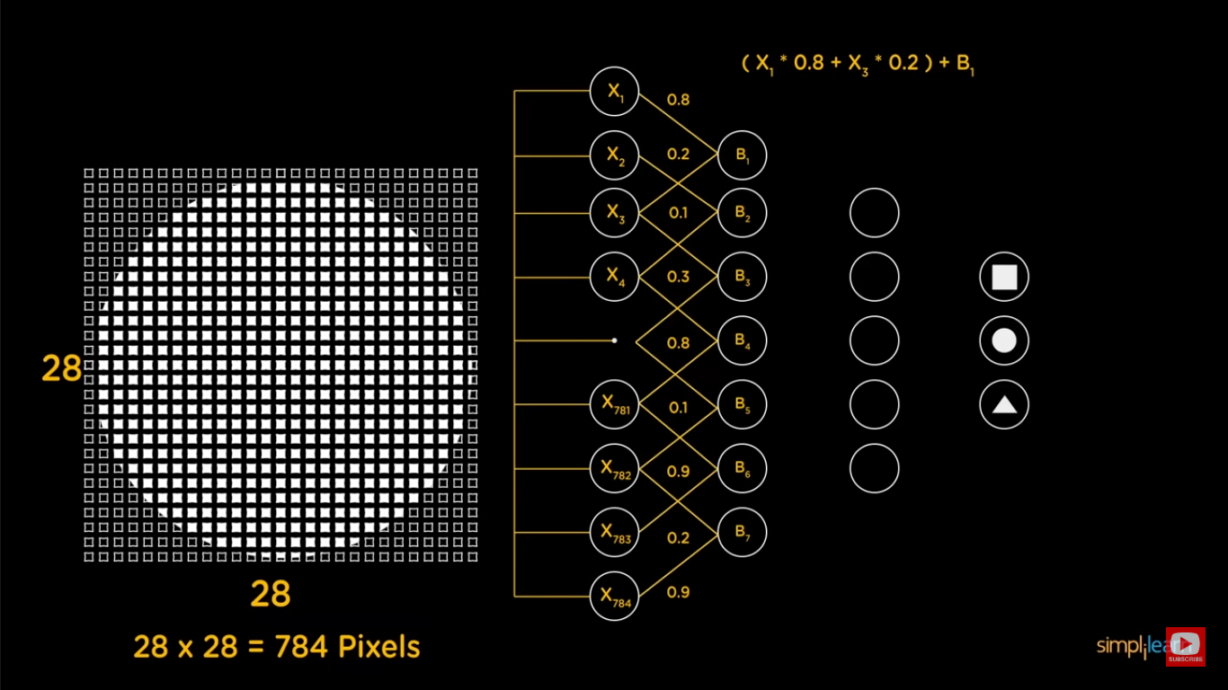

Slide 20
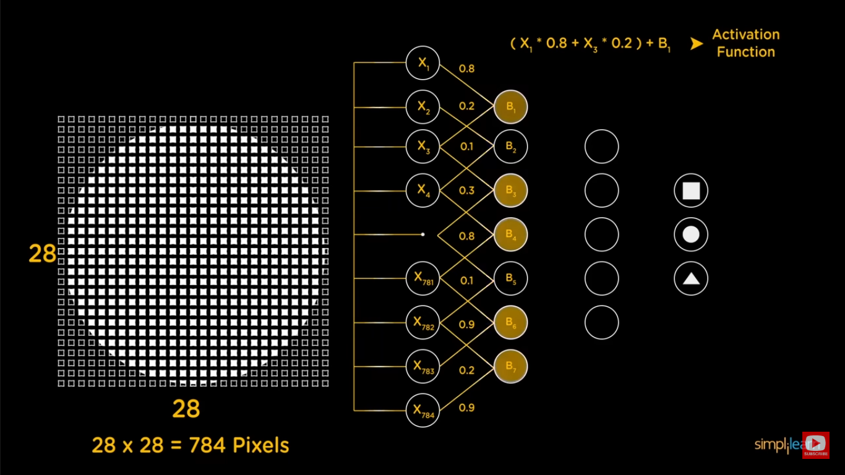

Slide 21
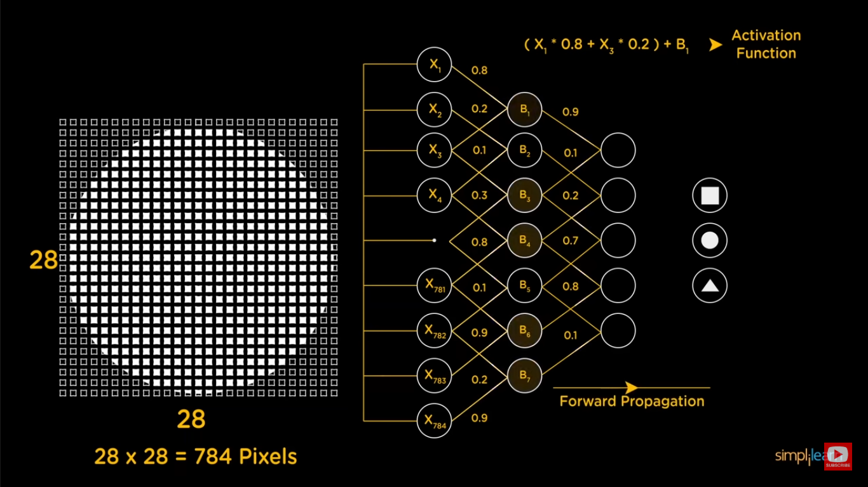

Slide 22
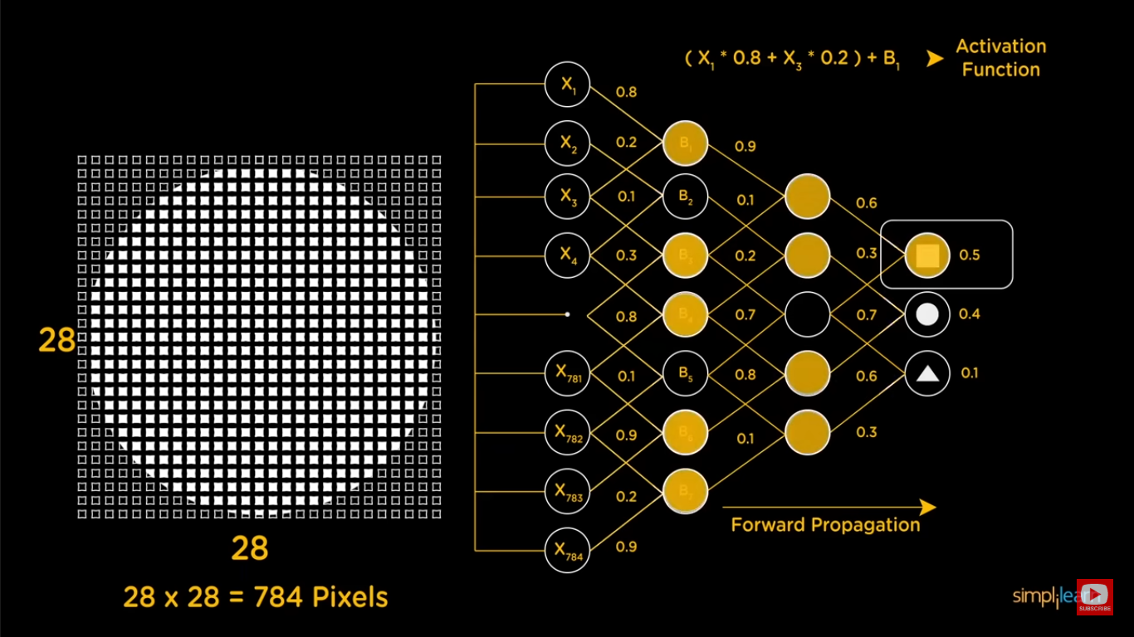

Slide 23
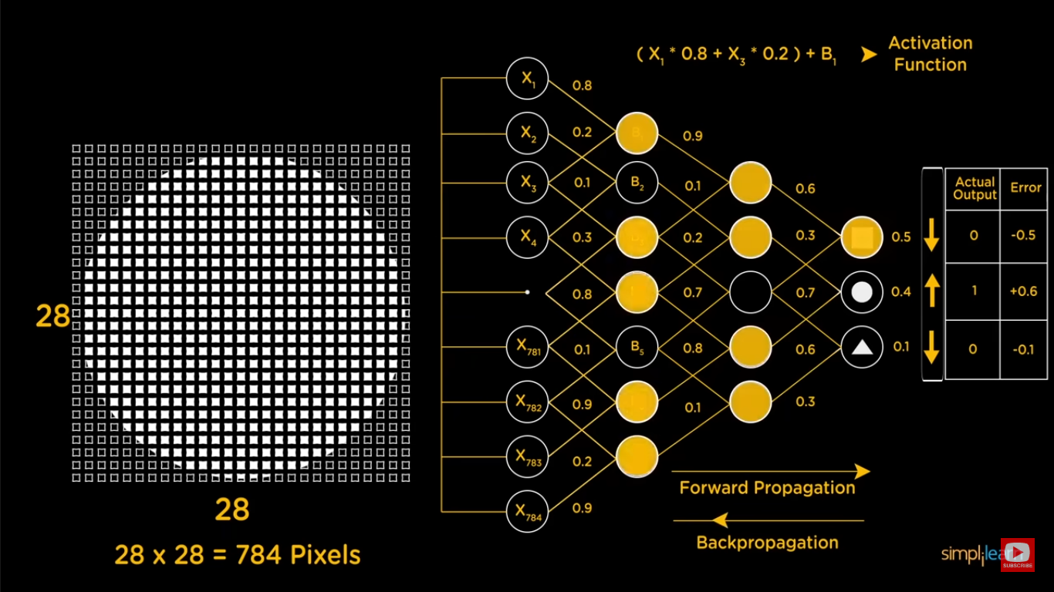

Slide 24
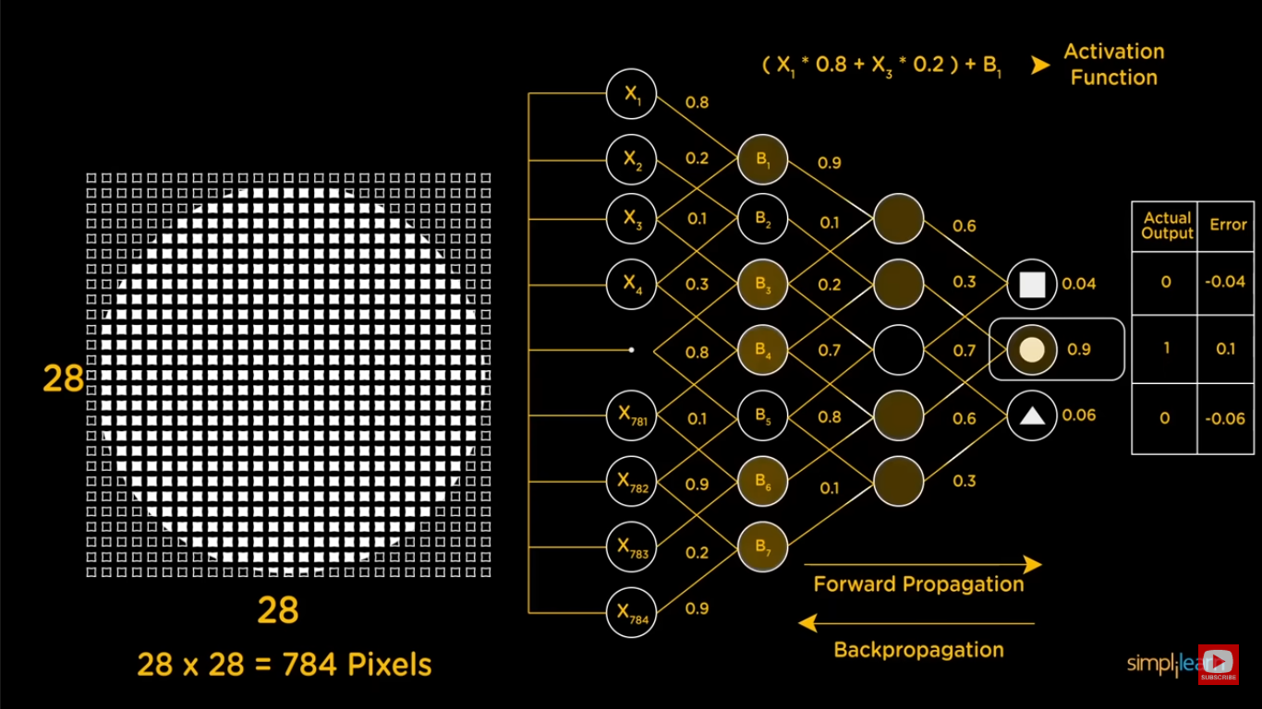

Slide 25
8x8 image
Image flattening
Then fed to neurons
4
7. Dicussion,Conclusion and Refrences

